Slide 1


SMART WATER FOUNTAIN

Slide 2
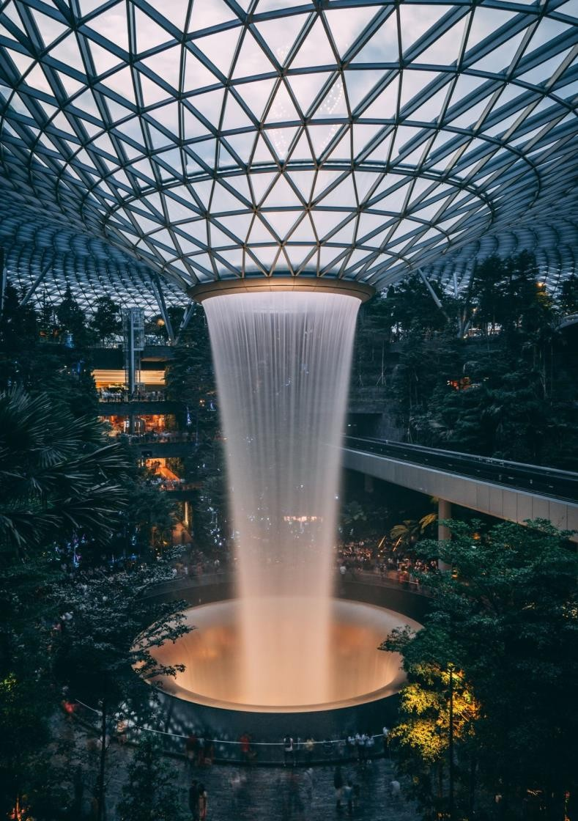
INTRODUCTION
Smart Water Fountain is a technology that can be integrated into the Smart City ecosystem with sensors that use real-time data analysis to monitor water quality and flow rate.Park, garden, forest, etc. It provides drinkable water service in areas, and provides access to water without touching thanks to the foot pedal.

Slide 3

COMPONENTS
Raspberry Pi
Ultrasonic sensor HC-SR04
LED ( To simulate the fountain)
Resistor
Stepper motor

Slide 4
SIMULATION
import time
# Import the time module for time delays # Define GPIO pin numbersTRIG_PIN = 2
# GPIO pin number for the ultrasonic sensor's
triggerECHO_PIN = 3
# GPIO pin number for the ultrasonic sensor's echoPUMP_PIN = 4
# GPIO pin number for the water pumpLED_PIN = 5 # GPIO pin number for the LED
# Initialize components (virtual components for
Wokwi)ultrasonic_sensor = Ultrasonic(TRIG_PIN, ECHO_PIN)
# Create an ultrasonic sensorpump = Motor(PUMP_PIN) # Create a water pumpled = LED(LED_PIN)

Slide 5
# Create an LEDwhile True:
# Measure distance
distance = ultrasonic_sensor.distance_cm # Measure distance in centimeters
if distance > 200:
# Water level is above 200 cm # Make the LED blink
led.blink(on_time=0.5, off_time=0.5)
# LED blinks with 0.5 seconds on and off time pump.on()
# Water pump is turned on else:
# Water level is below 200 cm
# Turn off the LED and the pump led.off() pump.off()
# Introduce a small delay to control the loop rate time.sleep(0.1)
# Sleep for 0.1 seconds

Slide 6

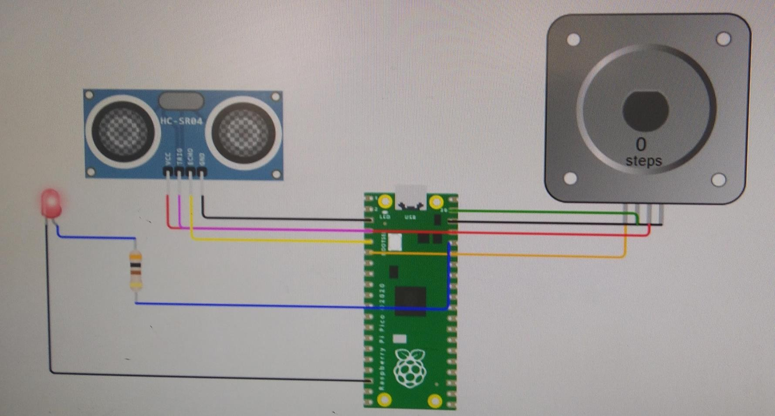
OUTPUT

Slide 7
OUTPUT LINK WOKWI
https://wokwi.com/projects/378906068399482881

Slide 8
SPECIFICATION
Mains water is filtered.
Filtered water under high pressure is transferred to the water tank inside the fountain for storage.
The quality of the filtered water is measured and it
is determined whether this water is suitable for drinking.
The amount of water used is recorded and this
data is transmitted in real time.
If necessary, the flow of water can be interrupted remotely.

Slide 9


